Slide 1
Covid-19 Classification
By
Amir Ali & Nader Tavana

Slide 2
Introduction
COVID-19 is a type of virus.
It is called Novell because it is a new strain of the virus and its combination with the number 19 since it appeared in 2019.
COVID-19 is a transferable virus caused by SARS-CoV-2.

Slide 3
Research Objective
To build an intelligent system for Coronavirus patients.
To implement a robust computer vision technique for detection.
To determine the most efficient extract features for CT Chest images.

Slide 4
Significance of Study
Patients don’t need to go to a special Medical Laboratory for the corona test.
Patients can check their own corona test.
An accurate method to detect Coronavirus patients.
Hospitals don’t need to invest in producing test kit.
Quick result and time saving.
Cost efficient method.

Slide 5
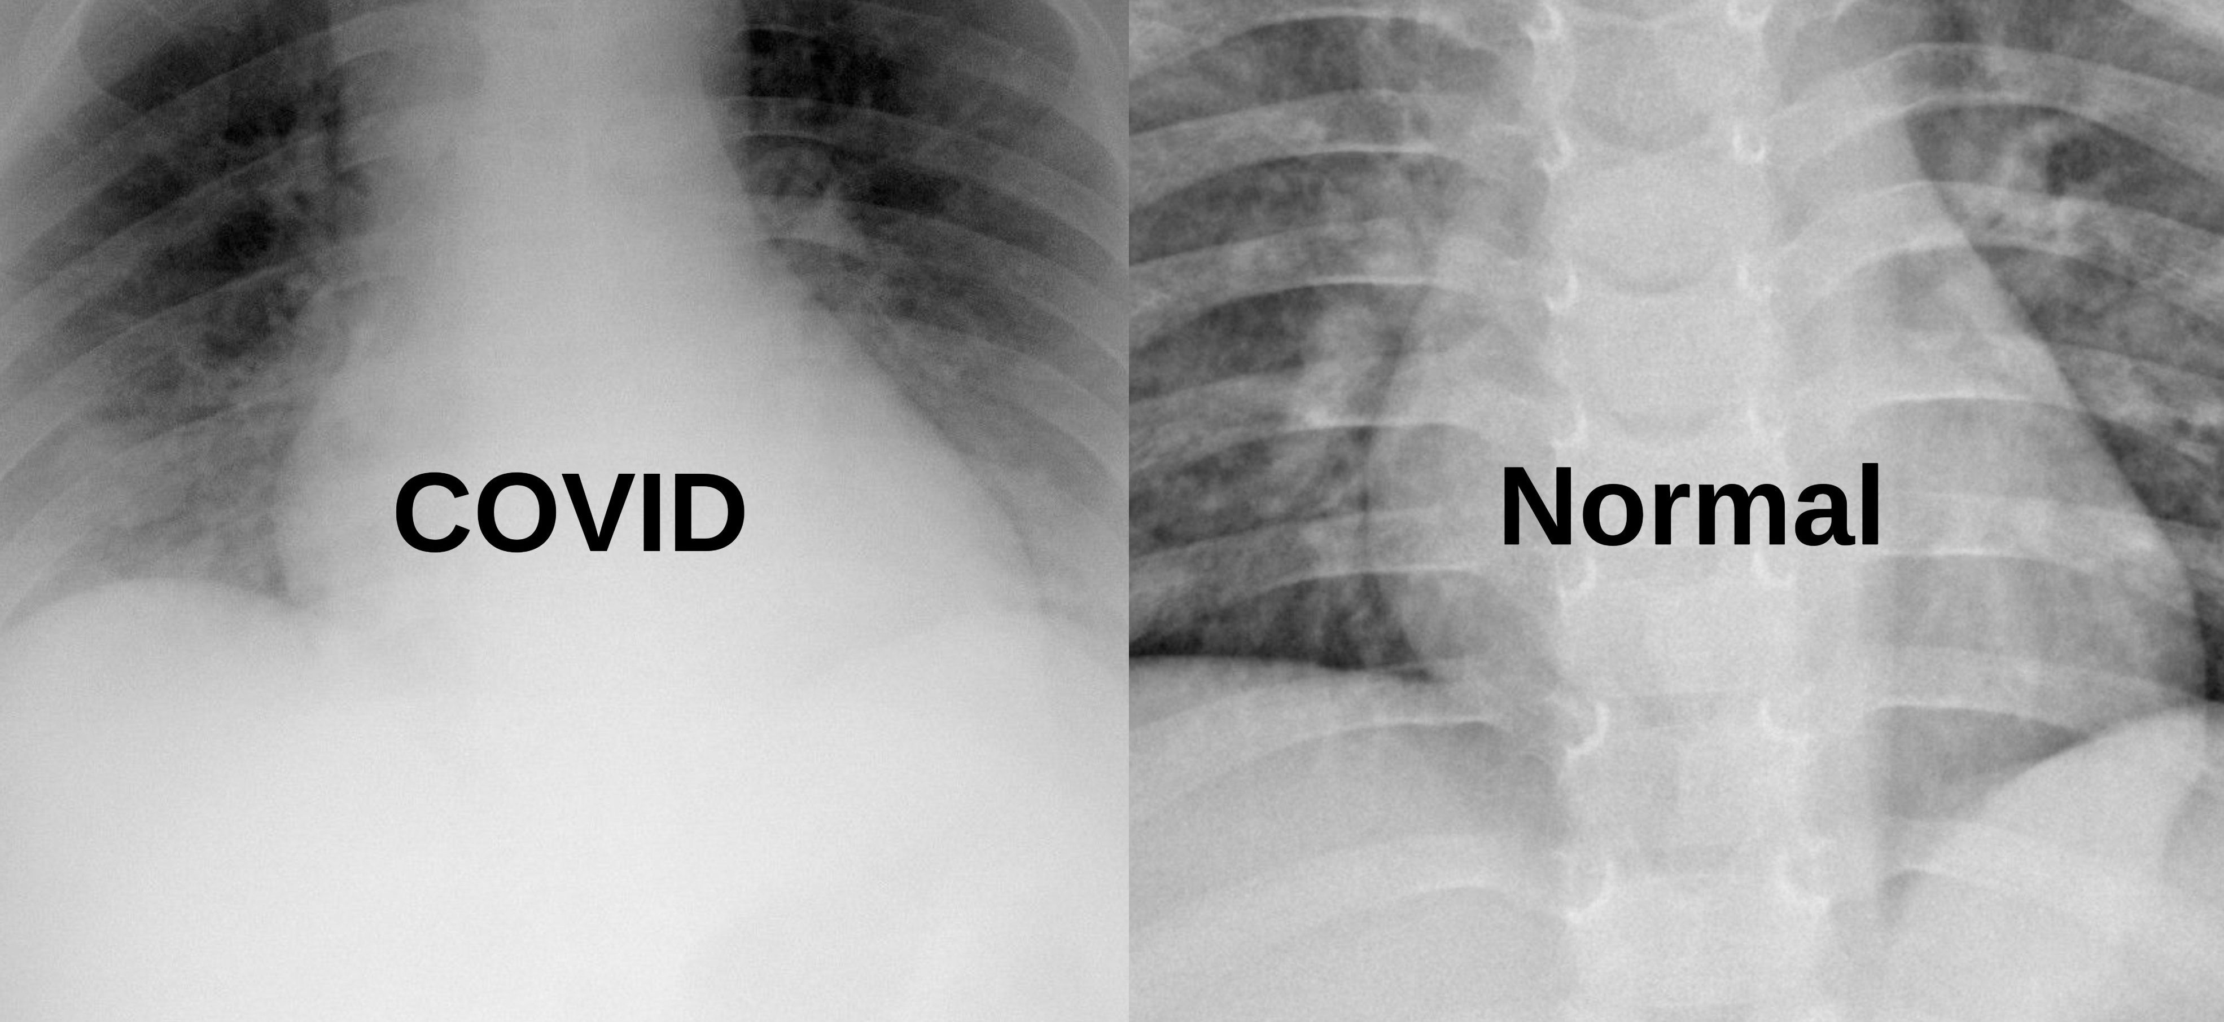
Dataset [1]
Two-class Classification
Three-Class Classification

Slide 6
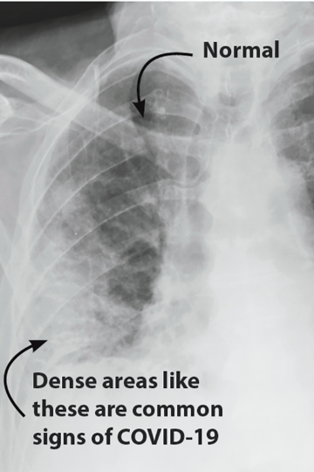
Power of Computer Vision Technique
[Image Source] https://www.iaea.org/bulletin/infectious-diseases/a-window-inside-the-body-and-covid-19

Slide 7
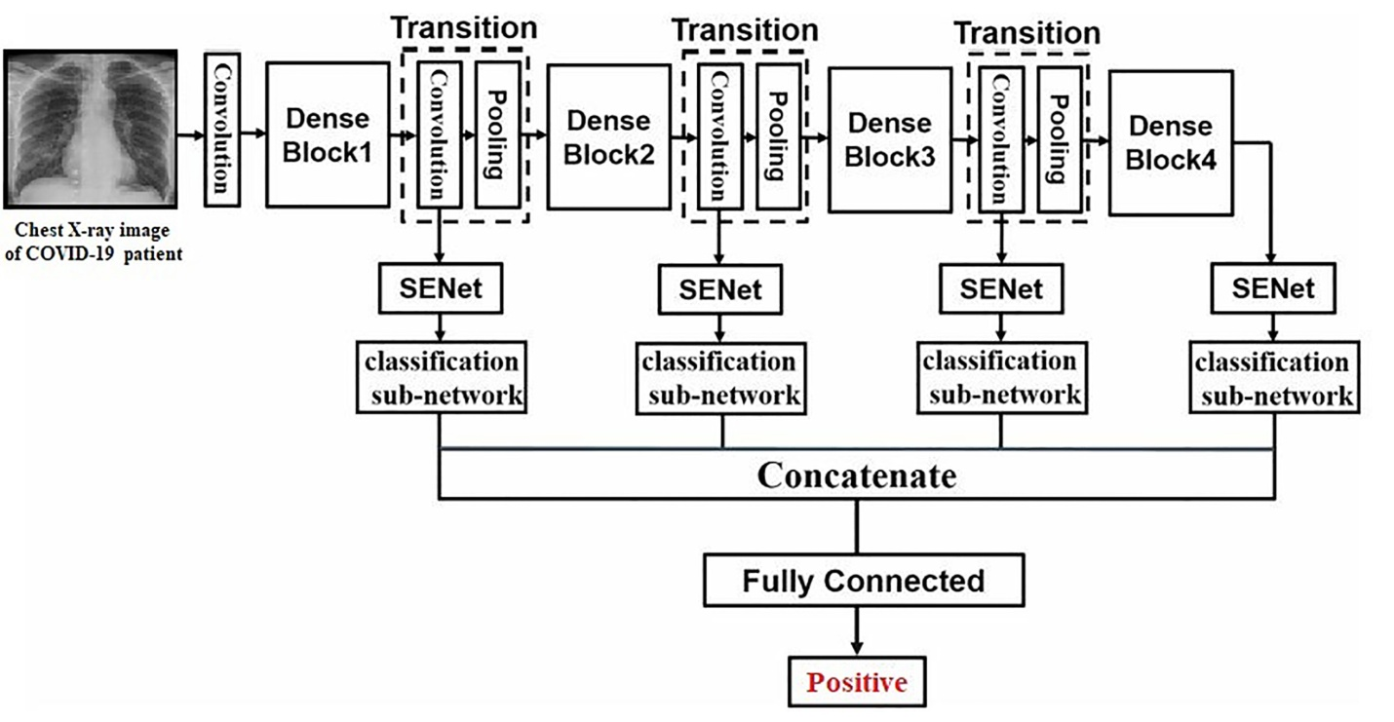
Methodology

Slide 8
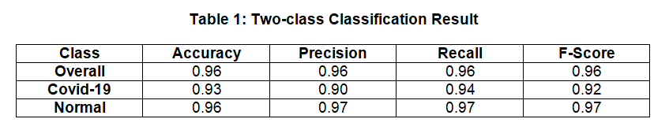
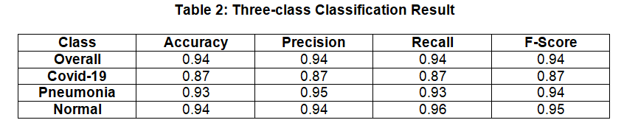
Result

Slide 9
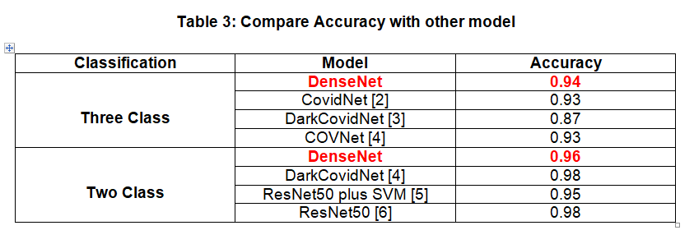
Compare Result with other Model

Slide 10
Conclusion
In this work, we showed a novel transfer learning-based approach to detect COVID-19. To assure that our model can differentiate COVID-19 radiology images from both healthy persons and pneumonia patients, we performed both 2-class and 3-class classifications. Our extensive experiments suggest that COVID-DenseNet can be used effectively for detecting COVID-19 from chest radiology images.

Slide 11
References
[1] https://www.kaggle.com/tawsifurrahman/covid19-radiography database
[2] Linda Wang and Alexander Wong. Covid-net: A tailored deep convolu-tional neural network design for detection of covid-19 cases from chest radiography images. 03 2020.
[3] Tulin Ozturk, Muhammed Talo, Eylul Azra Yildirim, Ulas Baran Baloglu, Ozal Yildirim, and U. Rajendra Acharya. Automated detection of COVID-19 cases using deep neural networks with x-ray images. Computers in Biology and Medicine, 121:103792, June 2020.
[4] Lin Li, Lixin Qin, Zeguo Xu, Youbing Yin, Xin Wang, Bin Kong, Junjie Bai, Yi Lu, Zhenghan Fang, Qi Song, Kunlin Cao, Daliang Liu, Guisheng Wang, Qizhong Xu, Xisheng Fang, Shiqin Zhang, Juan Xia, and Jun Xia. Artificial intelligence distinguishes covid-19 from community acquired pneumonia on chest ct. Radiology, 296:200905, 03 2020.
[5] Prabira Kumar Sethy and Santi Kumari Behera. Detection of coronavirus disease (COVID-19) based on deep features. March 2020.
[6] Ali Narin, Ceren Kaya, and Ziynet Pamuk. Automatic detection of coronavirus disease (covid-19) using x-ray images and deep convolutional neural networks, 2020

